Slide 1

IDENTIFICAção de topoi usando LIME
Lucas Freire Silva

Slide 2
O problema de pesquisa
As “máquinas produtoras de texto’: Jusnaturalismo
Positivismo
Realismo Jurídico
Tópica
Cerca de 30 k (1,4 mi de Pragrafos) acórdãos do SuPremo Tribunal Federal
Método:
Bert
LIME

Slide 3
Características de um Topos
Place | Description | Examples
(i) | I.5–14 (without I.6b—I.7) | specific topoi of the three species of speech | “Further, health, beauty, and the like are goods, for being bodily excellences and productive of many other good things.” “It is noble to avenge oneself on one's enemies and not to come to terms with them; for requital is just, and the just is noble.”
(ii) | I.6b | topoi on controversial goods | “That which most people seek after, and which is obviously an object of contention, is also a good; for, as has been shown, that is good which is sought after by everybody, and ‘most people’ is taken to be equivalent to ‘everybody’.”
(iii) | I.7 | topoi on the greater good (the better) | “Again, where one good is always accompanied by another, but does not always accompany it, it is greater than the other, for the use of the second thing is implied in the use of the first.”
(iv) | I.15 | topoi of non-technical means of persuasion | “We shall argue that justice indeed is true and profitable, but that sham justice is not, and that consequently the written law is not, because it does not fulfill the true purpose of law.”
(v) | II.2–11, II.12–17 | topoi to arouse emotions | “Again we are angry if something is not in line with what we expected, since what is not in line with what we expect provides more pain.”
(vi) | II.19 | topoi about the possible, the past, the future | “If the beginning of a thing can occur, so can the end; for nothing impossible occurs or begins to occur.”
(vii) | II.23–24 | common topoi (type 1) | “If a quality does not in fact exist where it is more likely to exist, it clearly does not exist where it is less likely.”
(viii) | II.23–24 | common topoi (type 2) | “Another line of argument is common to forensic and deliberative oratory, namely, to consider inducements and deterrents, and the motives people have for doing or avoiding the actions in question.”
(ix) | II.23–24 | common topoi (type 3) | “Another line is to apply to the other speaker what he has said against yourself.”
(x) | III.15 | topoi for slandering | “Another method is to denounce calumny, by saying what an enormity it is, and in particular that it raises false issues, and that it means a lack of confidence in the merits of his case.”

Slide 4
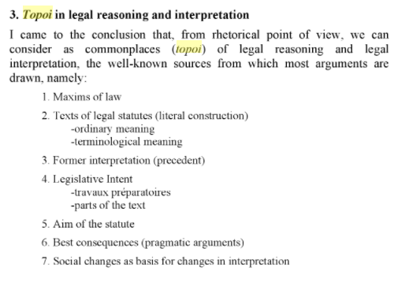
Características de um Topos

Slide 5
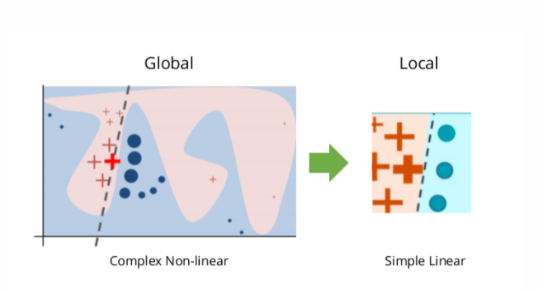
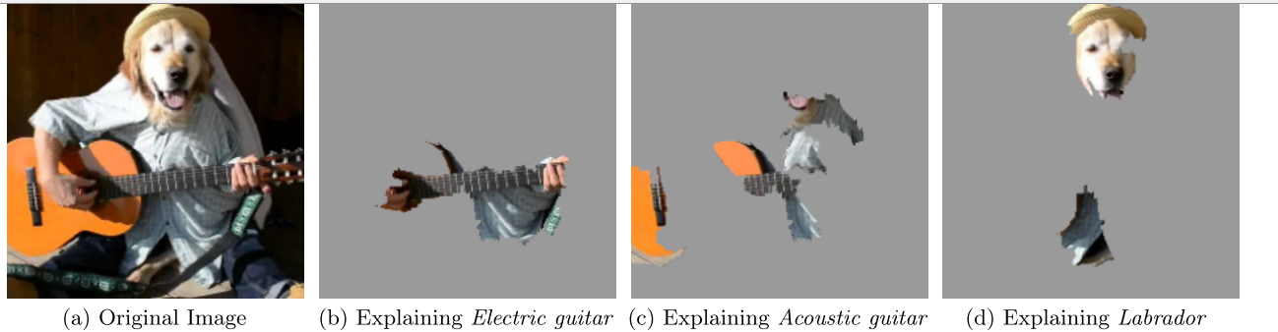
LIME
Trade-off entre complexidade e fidelidade

Slide 6
Como identificar categorias
Luz de Araujo, Pedro Henrique, Teófilo E. de Campos, Renato R.R. de Oliveira, Matheus Stauffer, Samuel Couto, and Paulo Bermejo. 2018. “LeNER-Br: A Dataset for Named Entity Recognition in Brazilian Legal Text.” Lecture Notes in Computer Science (Including Subseries Lecture Notes in Artificial Intelligence and Lecture Notes in Bioinformatics) 11122 LNAI: 313–23. https://doi.org/10.1007/978-3-319-99722-3_32.
Sartor, Giovanni. 2009. “Legal Concepts as Inferential Nodes and Ontological Categories.” Artificial Intelligence and Law 17 (3): 217–51. https://doi.org/10.1007/s10506-009-9079-7.
LKIF-Core
Core ontology of basic legal concepts
Specified using OWL-DL (SHOIN(D))
14 modules, 205 classes, 99 properties
Descriptive annotations
Documentation at http://www.estrellaproject.org/lkif-core/doc

Slide 7
Pesquisa futura
Active Learning (INCEpTION ?)
Categorização padronizada do conhecimento jurídico
Pré-processamento do texto, aquisição dos relatórios e organização dos metadados

